Slide 1

Lecture 2. Visualisation as the language of data

Slide 2



Festival of Economics.
1-3 October 2024
Book talks, panels & live podcast recordings – your chance to ask experts from around the world the key economic questions of our time!
Scan for tickets and the programme.
With the election of a new government after 14 years, the theme of the Festival is looking back, to look forward:
Legacies of Empire, Inequalities, The Tyranny of Nostalgia, Sustainable Futures, Labour’s first 100 days, Building a fair society, Britain’s place in the world , Social mobility, The kids aren’t alright, UK productivity, Tim Harford podcast
… and more!
FREE TICKETS for:
- Legacies of Empire (Tues 1 October, 7pm)
- Inequalities (Thursday 3 Oct, 7pm)
in the Wills Memorial Building and are free to UoB students

Slide 3
Lecture 2. Visualisation as the language of data
Chart types – code-along
[50 min]
[50 min]

Slide 4
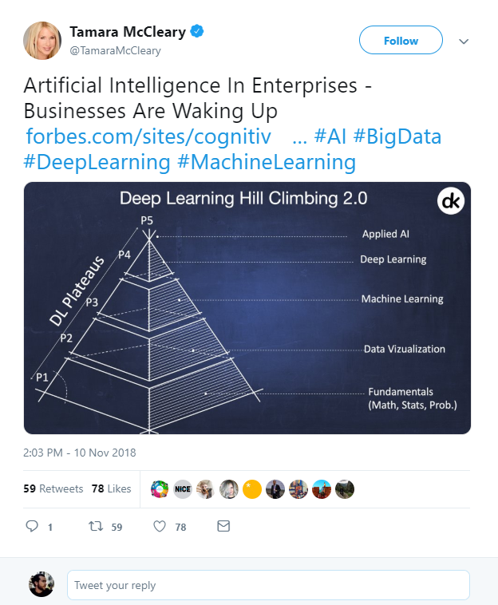

What is Data Science?
Artificial Intelligence?
Machine Learning?
Deep Learning?
Big Data?
https://twitter.com/TamaraMcCleary/status/1061197523610550272
Notes:
Tamara MCcleary – Tech Influencer
The data science pyramid
What do some of the more “fashionable” terms mean?
https://twitter.com/TamaraMcCleary/status/1061197523610550272

Slide 5


1 ZB zeta-exa-peta terra-giga-mega
Norhteastern, 2016
Notes:
In one year, humanity generates around 1ZB of data.
www.northeastern.edu/graduate/blog/how-much-data-produced-every-day/
If you take an average 10GB phone, that means 100 billion of phones.
If you take these phones and you stack them, screen to back, you could build one million 800m tall towers.
That is one Burj Khalifa for every pixel on this screen.

Slide 6
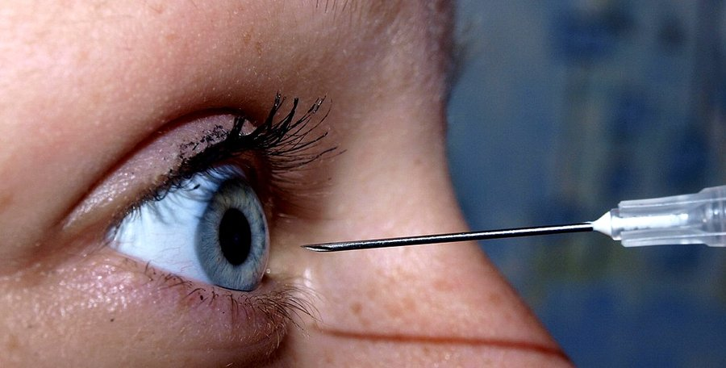
Attention ? At tension ?
Notes:
Data is practically infinite. But is your attention, too?

Slide 7


250 ms
Sabine Kastner et al., Princeton, 2018
Notes:
Sabine Kastner et al., Princeton, 2018
Your brain effectively has quarter of a second to decide what is important and what is not.

Slide 8

Attention poverty
"What information consumes is rather obvious: it consumes the attention of its recipients. Hence, a wealth of information creates a poverty of attention, and a need to allocate that attention efficiently among the overabundance of information sources that might consume it."
Herb Simon, as quoted by Hal Varian, Scientific American, 1995. Adapted from UW CSE442 and the original research by PARC UIR
Notes:
There is an overload of information.
We need a way to figure out what is important and what is not.

Slide 9


Big Data. Big Responsibility.
The Datasaurus, Autodesk, Alberto Cairo, 2017
Notes:
So there is too much data, but our attention is limited.
The art is then to extract what is important from that huge pile of data.
Welcome to Data Science.

Slide 10
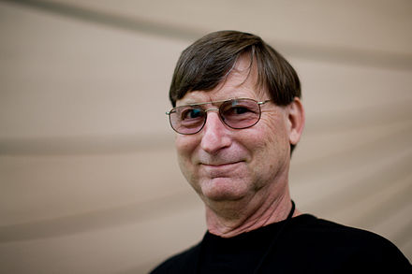
visualisation = understanding
"The ability to take data - to be able to understand it, to process it, to extract value from it, to visualize it, to communicate it - that's going to be a hugely important skill in the next decades, ...because now we really do have essentially free and ubiquitous data."
Hal Varian, Chief Economist, Google. The McKinsey Quarterly, 2009. Adapted from UW CSE442.
Notes:
There is an overload of information.
We need a way to figure out what is important and what is not.

Slide 11
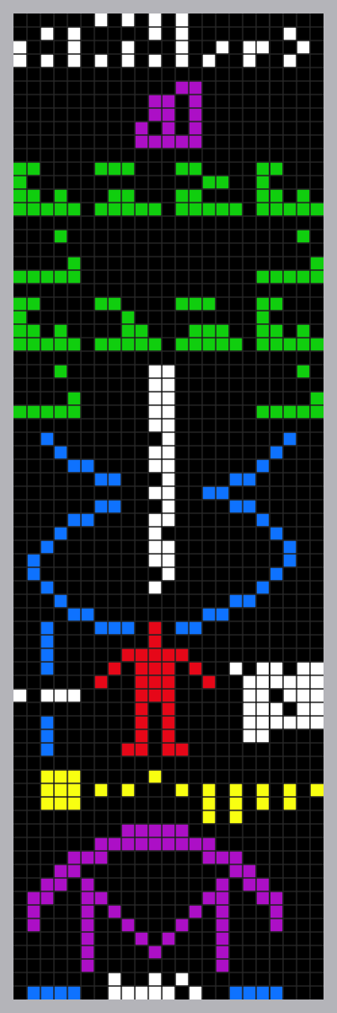

Data. Information. Knowledge.
Notes:
Arecibo message. This is data science. Find what’s important in a sea of data. That’s useful information. Put that information into context. That is knowledge.
In David McCandless’ book, Knowledge is Beautiful, something similar is the inner cover photo.
In this particular course, we will be dealing with the part of data science that you might call “Business Inteligence”.
This is exactly the Data->Information->Knowledge process.
https://www.datapine.com/blog/business-intelligence-for-small-business/

Slide 12
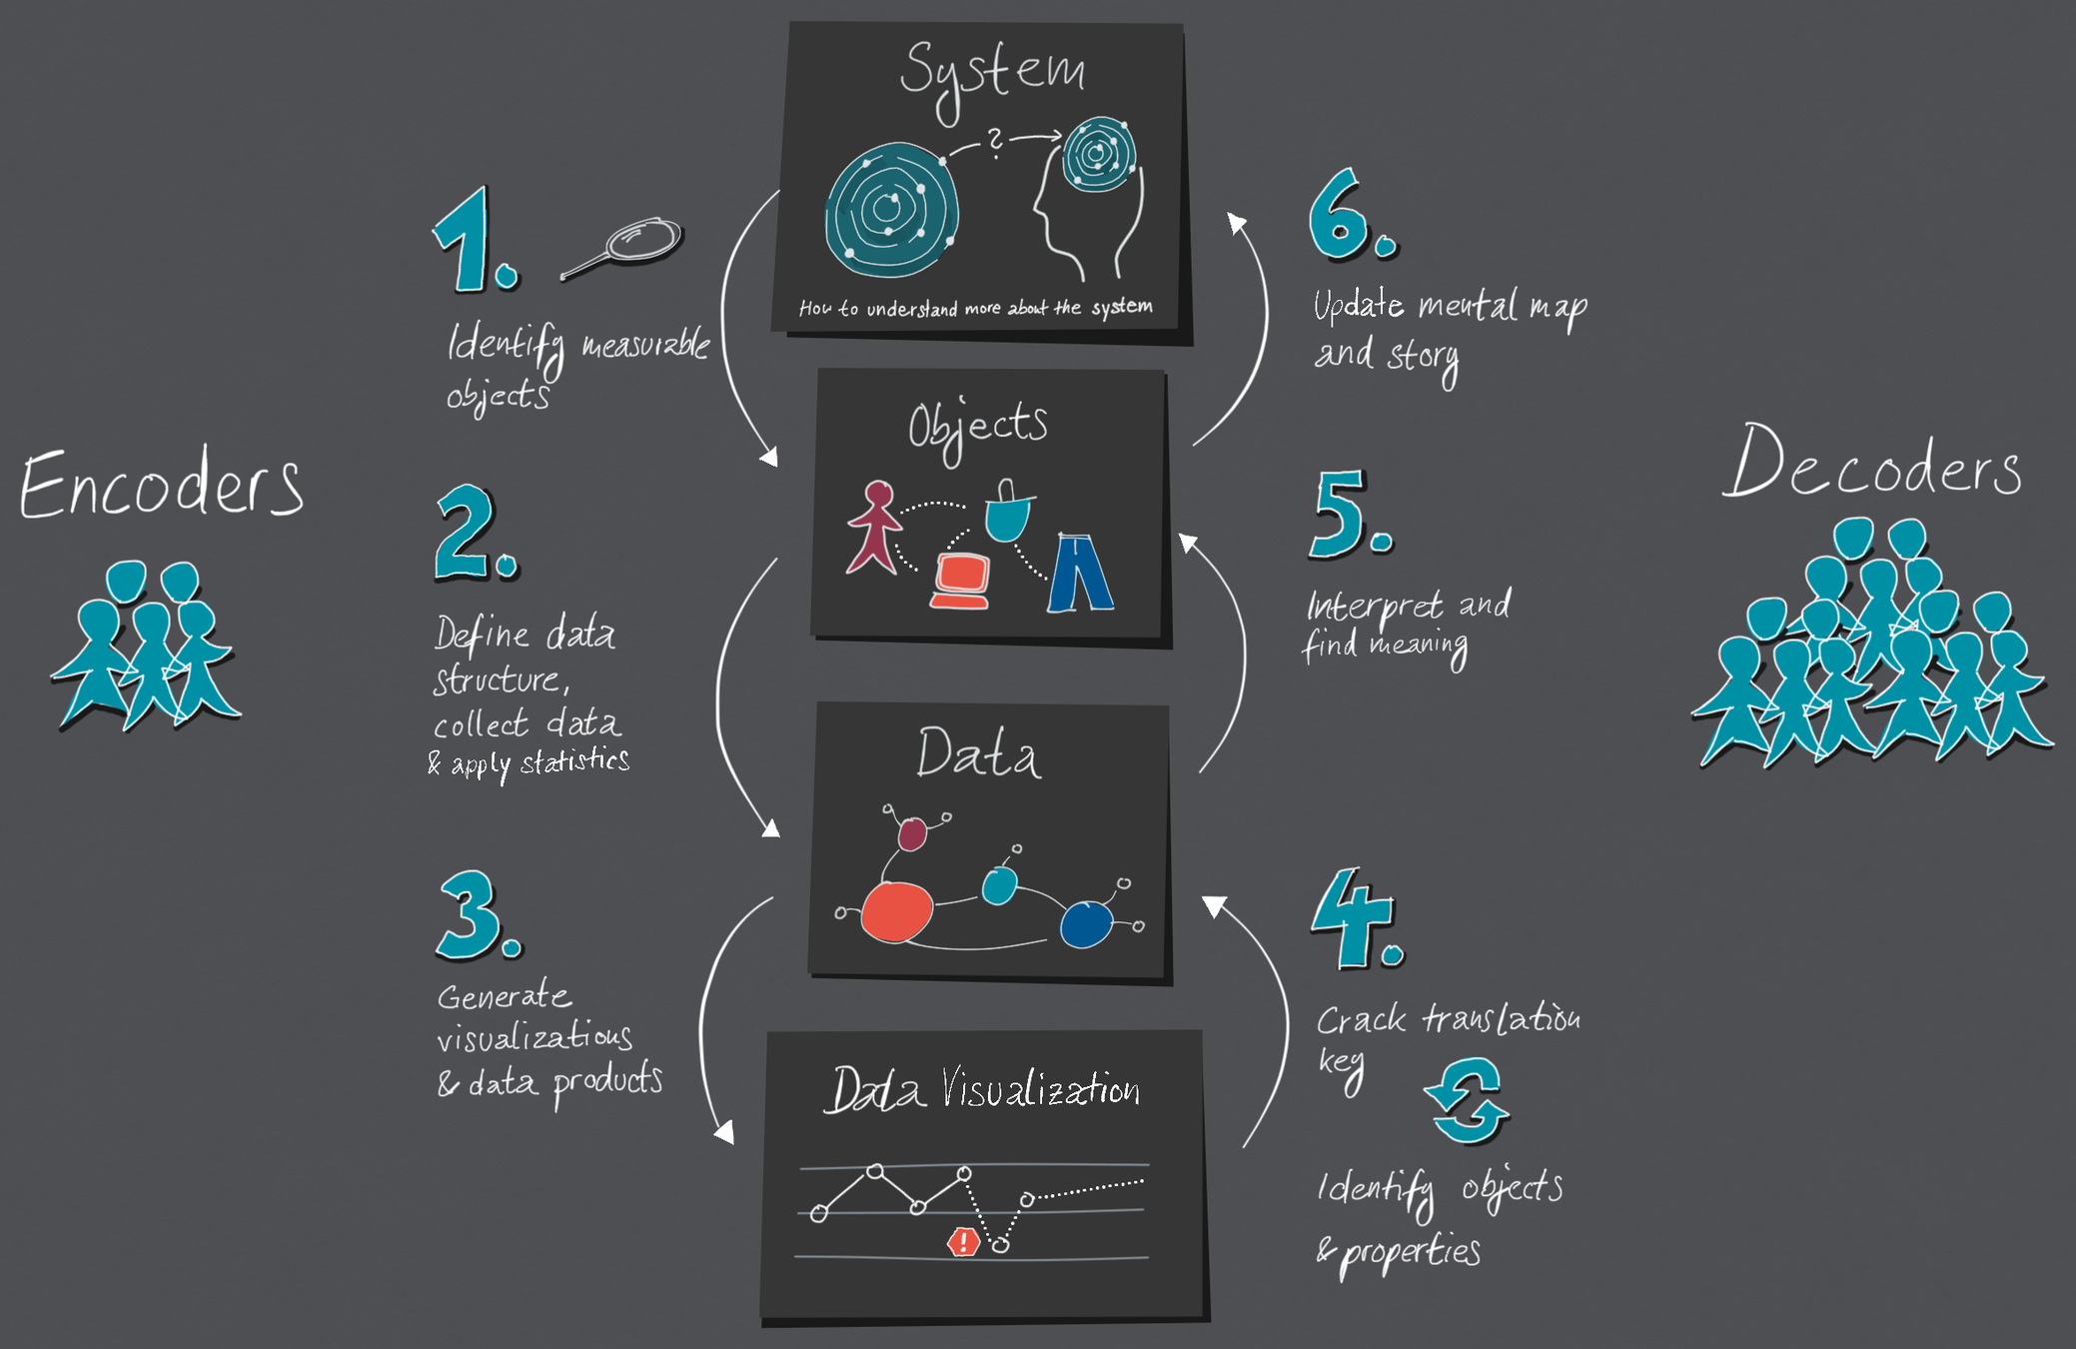

https://medium.com/nightingale/the-cycle-of-encoding-and-decoding-f3ff17010631
Notes:
Data visualisation is a language of conversing with data.
https://medium.com/nightingale/the-cycle-of-encoding-and-decoding-f3ff17010631

Slide 13
visual language.
Notes:
Open-floor question on what IS data science?

Slide 14

Visual language is a sign system.
Images perceived as a set of signs.
Sender encodes information in signs.
Receiver decodes information from signs.
In his foreword to the 1983 English translation Howard Wainer called Bertin's work, the most important work on graphics since the publication of Playfair's Atlas
Jacques Bertin, Semiologie Graphique, 1967

Slide 15
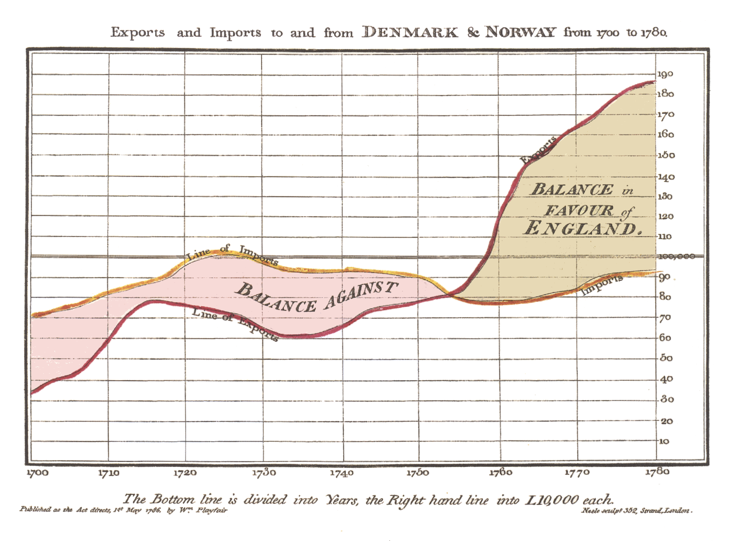
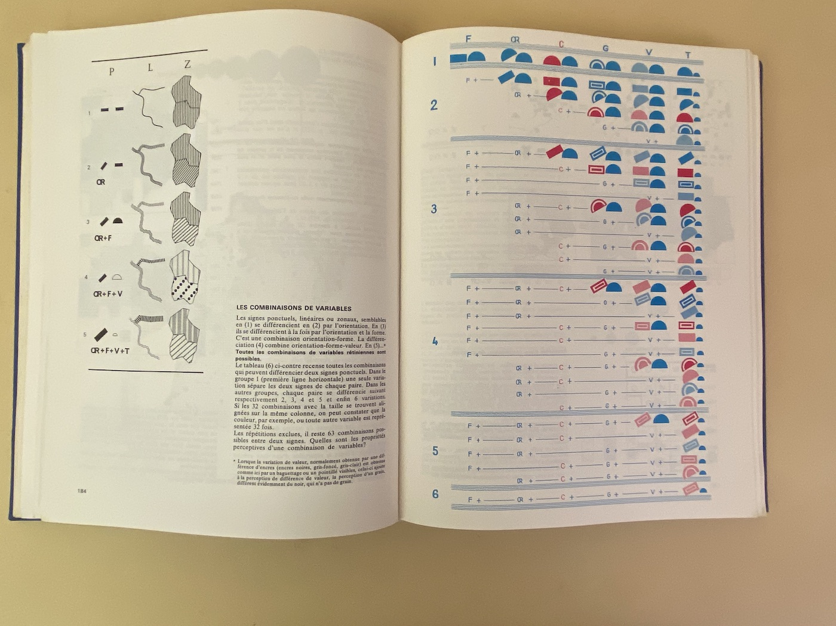
Visual language is a sign system.
William Playfair, The Commerical and Political Atlas, 1785 and Jacques Bertin, Semiologie Graphique, 1967
both collected from Jemery Norman’s HistoryOfIformation.com, 2021
Notes:
https://www.historyofinformation.com/detail.php?entryid=2929
https://www.historyofinformation.com/detail.php?id=3361

Slide 16
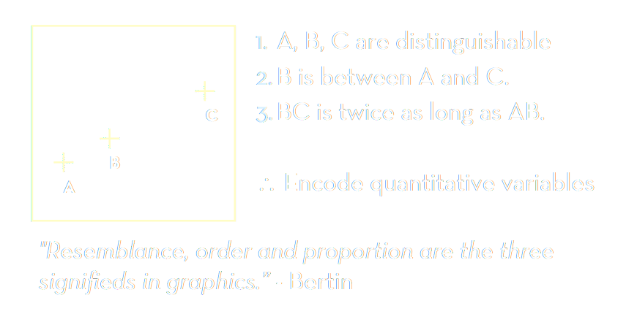
Bertin’s semiology of graphics.
Adapted from Jeffrey Heer, 2018, UW CSE442, after Jacques Bertin, Semiologie Graphique, 1967
Notes:
https://www.historyofinformation.com/detail.php?entryid=2929
https://www.historyofinformation.com/detail.php?id=3361

Slide 17
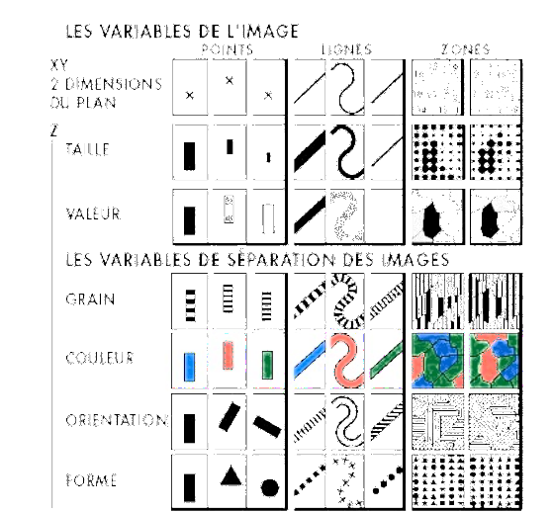
Visual encoding variables. Visual Grammar.
Position (x2)
Size
Value (Saturation)
Texture
Colour
Orientation
Shape
(Time/Animation, Focus, Opacity)
Adapted from Jeffrey Heer, 2018, UW CSE442, after Jacques Bertin, Semiologie Graphique, 1967
Notes:
https://www.historyofinformation.com/detail.php?entryid=2929
https://www.historyofinformation.com/detail.php?id=3361

Slide 18
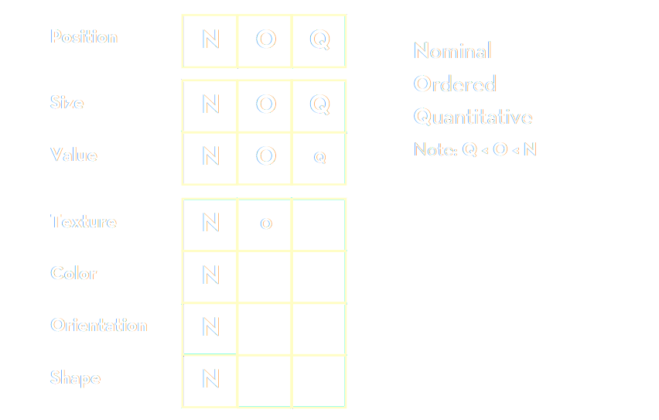
Bertin’s “Levels of Organisation”
Bertin’s list: based on theoretical considerations of semiology
Adapted from Jeffrey Heer, 2018, UW CSE442, after Jacques Bertin, Semiologie Graphique, 1967
Notes:
Bertin’s list – based on theoretical considerations of semiology

Slide 19
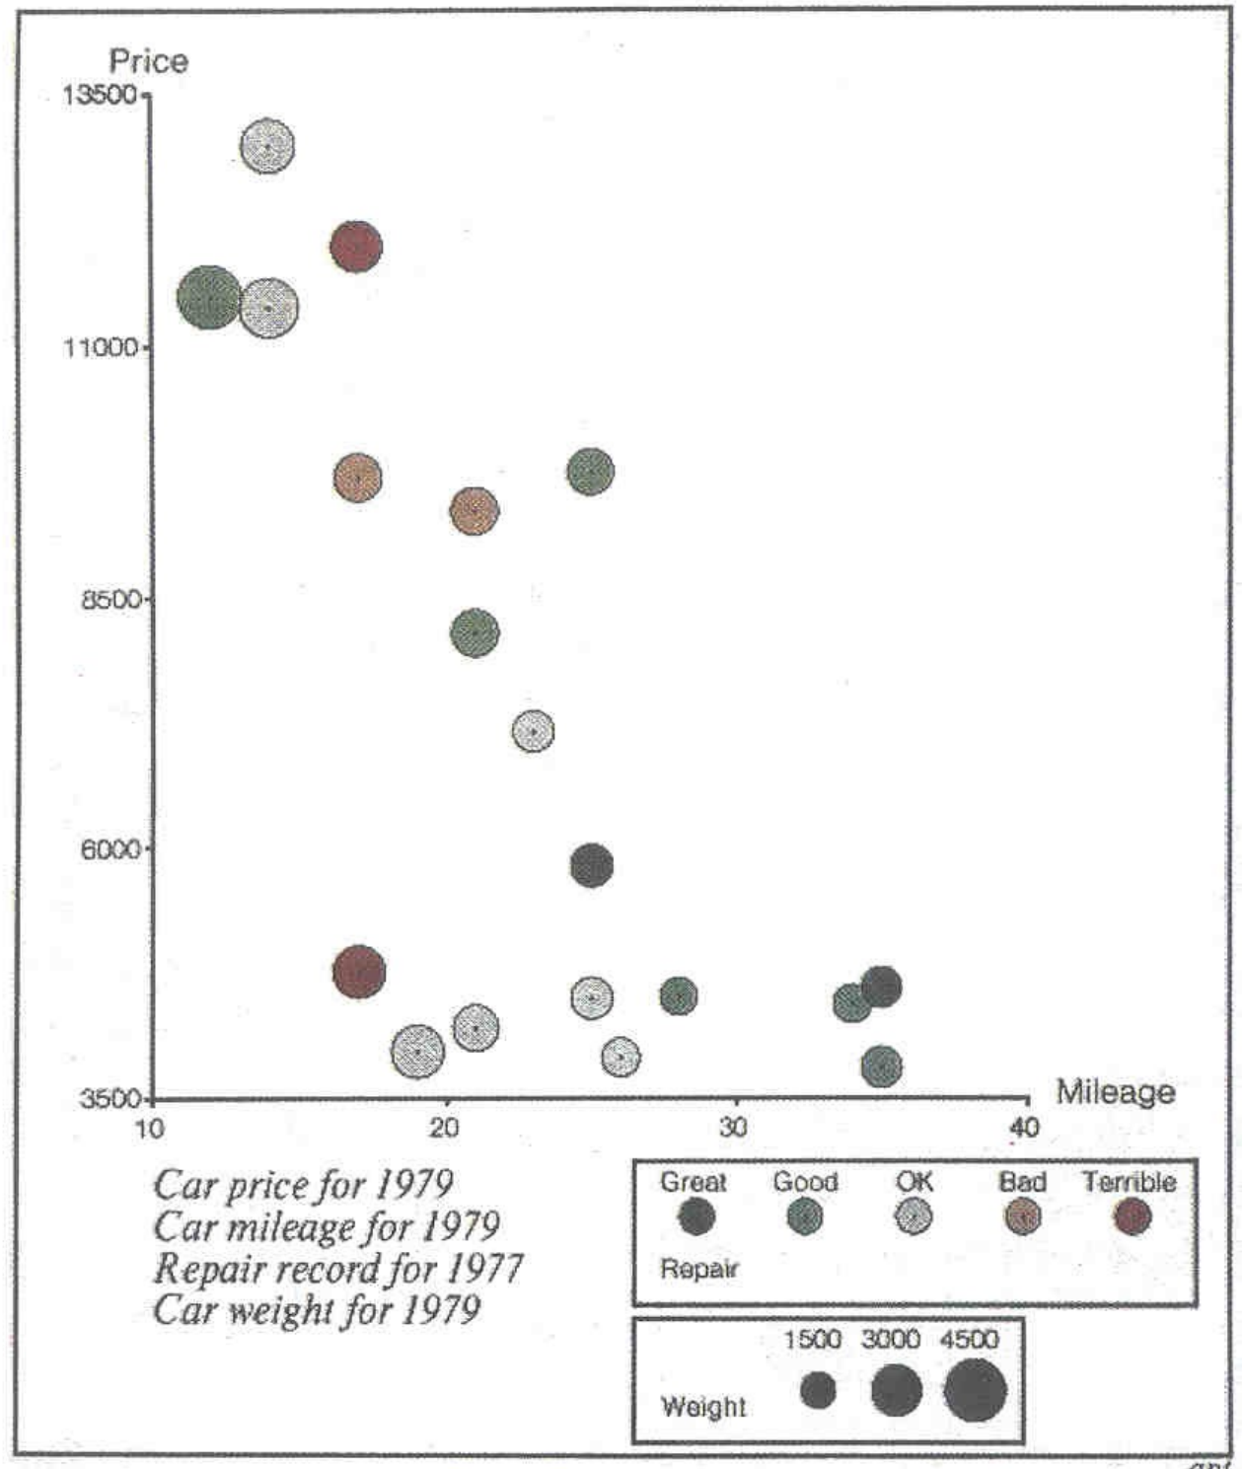
Mackinlay design criteria.
Formalizes Bertin for machines.
Expresiveness A set of facts is expressible in a visual language if the sentences (i.e. the visualisations) express all the facts in the set of data, and only the facts.
Effectiveness A visualisation is more effective than another if the information conveyed by one visualisation is more readily perceived than the information in the other visualization.
Adapted from Jeffrey Heer, 2018, UW CSE442 and Jock Mackinlay’s presentation at Ohio State University, 2005,
both based on Jock Mackinlay, Tableau/Xerox PARC/Stanford 1986
Notes:
http://web.cse.ohio-state.edu/~machiraju.1/teaching/CSE5544/mackinlay_midterm_material.pdf
Vice President of Visual Analysis at Tableau
https://www.tableau.com/learn/whitepapers/data-storytelling-using-visualization-share-human-impact-numbers

Slide 20
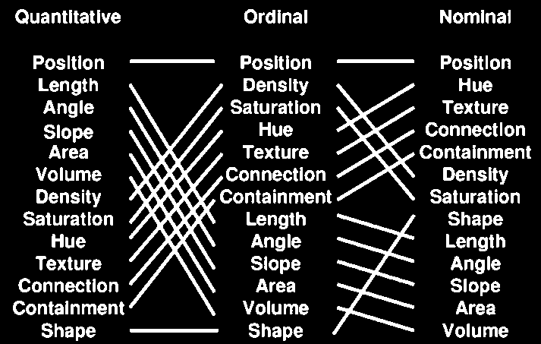
Mackinlay design criteria.
Mackinlay’s list: based on his experiments with computer graphics, trying to automate and formalize the creation of charts
The Vega visual language/grammar is built on Mackinlay’s work
Jock Mackinlay, Tableau/Xerox PARC/Stanford 1986
Notes:
Mackinlay’s list – based on his experiments with computer graphics, trying to automate and formalize the creation of charts
The first charting algorithms. The Vega visual language/grammar is built on Mackilnay’s work.

Slide 21
Which square is lighter?
Notes:
http://web.cse.ohio-state.edu/~machiraju.1/teaching/CSE5544/mackinlay_midterm_material.pdf
Vice President of Visual Analysis at Tableau
https://www.tableau.com/learn/whitepapers/data-storytelling-using-visualization-share-human-impact-numbers

Slide 22
Which square is lighter?
217, 217, 217
> 2 %
212, 212, 212
Notes:
http://web.cse.ohio-state.edu/~machiraju.1/teaching/CSE5544/mackinlay_midterm_material.pdf
Vice President of Visual Analysis at Tableau
https://www.tableau.com/learn/whitepapers/data-storytelling-using-visualization-share-human-impact-numbers

Slide 23
How many times is the right circle larger?
Notes:
http://web.cse.ohio-state.edu/~machiraju.1/teaching/CSE5544/mackinlay_midterm_material.pdf
Vice President of Visual Analysis at Tableau
https://www.tableau.com/learn/whitepapers/data-storytelling-using-visualization-share-human-impact-numbers

Slide 24
How many times is the top bar longer?
7
Notes:
http://web.cse.ohio-state.edu/~machiraju.1/teaching/CSE5544/mackinlay_midterm_material.pdf
Vice President of Visual Analysis at Tableau
https://www.tableau.com/learn/whitepapers/data-storytelling-using-visualization-share-human-impact-numbers

Slide 25
What colour do you see?
Notes:
http://web.cse.ohio-state.edu/~machiraju.1/teaching/CSE5544/mackinlay_midterm_material.pdf
Vice President of Visual Analysis at Tableau
https://www.tableau.com/learn/whitepapers/data-storytelling-using-visualization-share-human-impact-numbers

Slide 26
What colour do you see?
Notes:
http://web.cse.ohio-state.edu/~machiraju.1/teaching/CSE5544/mackinlay_midterm_material.pdf
Vice President of Visual Analysis at Tableau
https://www.tableau.com/learn/whitepapers/data-storytelling-using-visualization-share-human-impact-numbers

Slide 27
What colour do you see?
Notes:
http://web.cse.ohio-state.edu/~machiraju.1/teaching/CSE5544/mackinlay_midterm_material.pdf
Vice President of Visual Analysis at Tableau
https://www.tableau.com/learn/whitepapers/data-storytelling-using-visualization-share-human-impact-numbers

Slide 28

Stevens’ power law.
length
taste
weight
shock
sensation = intensity^{exponent}
Our senses are not linear!
area
volume
loudness
sensation →
intensity →
Stanley Smith Stevens, Harvard, 1957
Notes:
http://web.cse.ohio-state.edu/~machiraju.1/teaching/CSE5544/mackinlay_midterm_material.pdf
Vice President of Visual Analysis at Tableau
https://www.tableau.com/learn/whitepapers/data-storytelling-using-visualization-share-human-impact-numbers

Slide 29
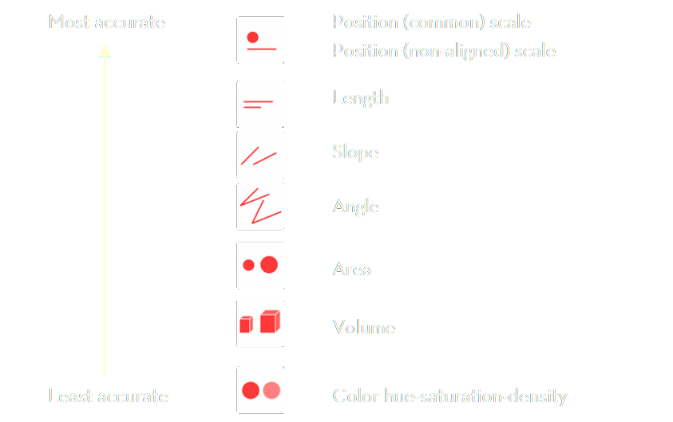
Stevens’ power law.
Stevens’ list: based on psychological experiments with human senses
Stanley Smith Stevens, Harvard, 1957

Slide 30
Visual language is a sign system.
When designing visual information use correct encodings
data → information correct data model
information → knowledge correct visual representation
Bertin’s semiology of graphics
Mackinlay design criteria
Stevens’ power law

Slide 31
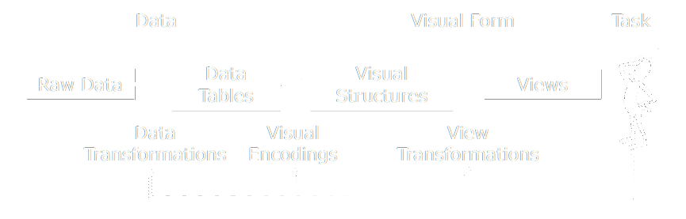
visualisation reference model
Jeffrey Heer, 2018. Adapted from UW CSE442.
Notes:
There is an overload of information.
We need a way to figure out what is important and what is not.

Slide 32
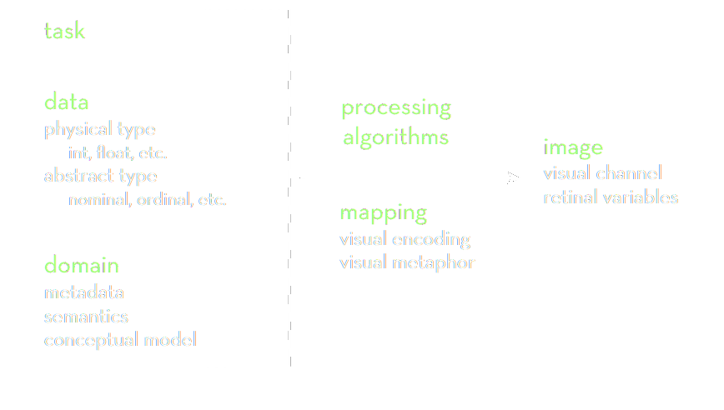
data → visualisation process
Jeffrey Heer, 2018. Adapted from UW CSE442.
Notes:
There is an overload of information.
We need a way to figure out what is important and what is not.

Slide 33
Data visualization zoo.
The actual “A Tour through the Visualisation Zoo”
Economics Observatory 🌌 Visualisation Guidelines
Financial Times Visual Vocabulary
Vega Edition of the Visual Vocabulary
The D3 Graph Gallery
Andy Kirks's The Chartmaker Directory
Heer, Bostock, Ogievetsky, A Tour through the Visualization Zoo, ACM, 2010
Notes:
https://homes.cs.washington.edu/~jheer/files/zoo/

Slide 34
visual encoding.
Notes:
Open-floor question on what IS data science?

Slide 35
data models | conceptual models
Data models are a low-level description of the data.
Math: sets with operations on them ( + / · ). How many? / What kind?
Conceptual models are higher level mental abstractions.
Semantics and support reasoning. What does is mean/describe?
Examples:
1D float vs Temperature
3D float vs Space
Jeffrey Heer, 2018. Adapted from UW CSE442.
Notes:
Data model machine language

Slide 36
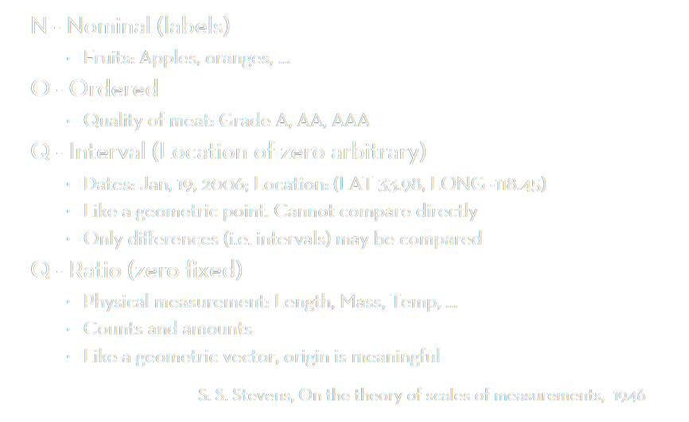
data types
O/Q
(T)
Notes:
Data model machine language

Slide 37
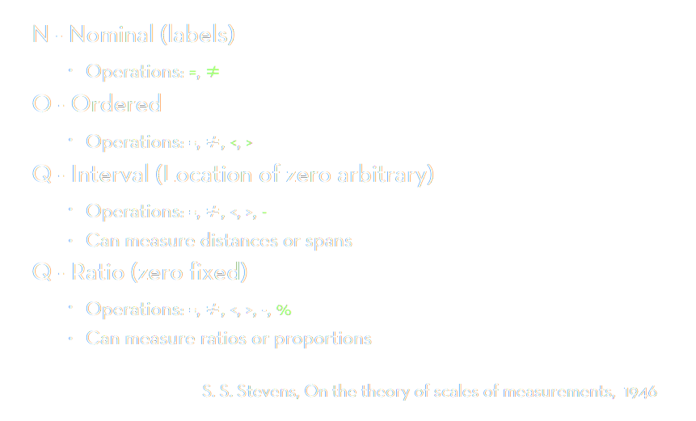
data types
O/Q
(T)
Notes:
Data model machine language

Slide 38
from model to type
Data model 12.3, red, A, 2021-10-111
Conceptual model temperature, colour, candidate ID, date
Working together:
Putting the data into the correct context → correct data type
Watch out for data traps!
“B” can be nominal or ordinal
“February” can be nominal or ordinal (special case of temporal)
“2021” can be anything

Slide 39
data → visualisation process
Jeffrey Heer, 2018. Adapted from UW CSE442.
Notes:
There is an overload of information.
We need a way to figure out what is important and what is not.

Slide 40
Data standards
TIDY data. Standardising data
Official sources. Getting data from curated sources
Data scraping. Augmenting your data from various sources

Slide 41
TIDY data
this (wide form)
should be converted to this (long form)
Country | 2019 | 2020 | 2021
Austria | 42 | 13 | 69
Belgium | 75 | 12 | 77
Country | Year | Value
Austria | 2019 | 42
Austria | 2020 | 13
Austria | 2021 | 69
Belgium | 2019 | 75
Belgium | 2020 | 12
Belgium | 2021 | 77
Notes:
Data model machine language

Slide 42
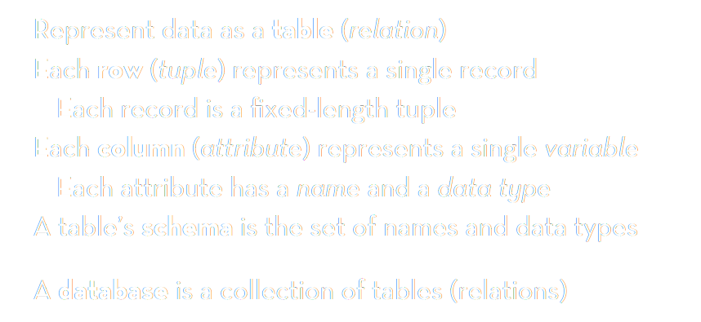
TIDY data
pandas: DataFrame
JavaScript: Object Array
Jeffrey Heer, 2018. Adapted from UW CSE442.
Notes:
There is an overload of information.
We need a way to figure out what is important and what is not.

Slide 43
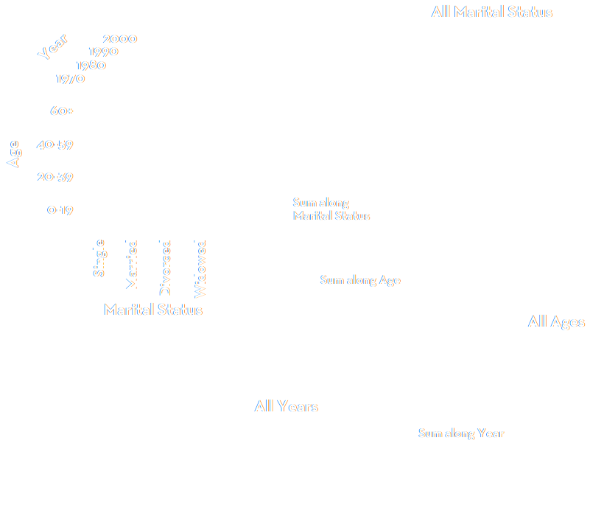
slice or dice
Jeffrey Heer, 2018. Adapted from UW CSE442.
Notes:
There is an overload of information.
We need a way to figure out what is important and what is not.

Slide 44
data guidelines.
Notes:
Open-floor question on what IS data science?

Slide 45

Data guidelines
Economics Observatory 📐 Data Guidelines ↗
We strive to maintain all data displayed on the site in a standardized, TIDY format. That means that every data point is a row (line) and every data feature is a column. The first column is called the index, and it is the typcially the column, based on which each of the data points gets a unique identifier. Sometimes the index column of datasets is a date, in which case we can treat the the data series as time series.
Economics Observatory 🌌 Visualisation Guidelines ↗
Dénes Csala, Economics Observatory, 2021, based on Hadley Wickham, RStudio, 2012
Notes:
Data model machine language

Slide 46
🌌 Charting guidelines For every chart we create, we should try to parametrise as much as possible, loading the color schemes and styles directly from a guideline repository or folder. This allows us to maintain a consistent style for our charts and, if needed, correct appearance bugs and update all charts created in the past with new styles. The inspiration comes from the Urban Institute's Dataviz Styleguide. Whenever possible, we try to automate the applying of styles to plots through themes. For Vega, themes look like this, which also translates to Altair.

Slide 47
Aesthetic zens we should strive follow are those of:
David McCandless (and the charts presented in Information is Beautiful and Knowledge is Beautiful, and more recently Beautiful News)
Nadieh visualcinnamon Bremer (and the charts presented in Data Sketches, together with Shirley Wu)
Lisa Charlotte Rost
Maarten Lambrechts
Andy Kirk (and the charts presented in Data Visualisation)
Nathan Yau
The Pudding

Slide 48
When creating charts, usually the first step is to envisage the type of chart that can accurately represent the underlying data, with all of its internal complexity. In order to help with this process, we can use a visual vocabulary. A few good ones are:
Financial Times Visual Vocabulary
Tableau Visual Vocabulary
Vega Edition of the Visual Vocabulary
PowerBI Edition of the Visual Vocabulary
Voyager, powered by CompassSQL
Andy Kirks's The Chartmaker Directory
Christophe Viau's D3.js Chart Gallery
The D3 Graph Gallery
The Observable Community
The Data Visualisation Catalogue
The Awesome-dataviz list
The cube.js list

Slide 49
👩‍💻 Coding guidelines
When creating explorable charts, interactives or dashboards, the tools we use are:
Panel in Anaconda's Holoviz package (also known for Bokeh) for easy interactivity and mixed chart types
Grafana for something beautiful from streaming or lots of data
Superset for an all-out open-source BI dashboard (albeit with a steep learning curve!)
PowerBI if open source is not so important

Slide 50
Coding zens
we follow are those of:
Jeffrey Heer of idl, the cradle of modern visualisation tools, such as Vega, D3.js and Tableau.
Datawheel, creators of D3plus
Mike Bostock, D3.js legend and creator of Observable
Jake VanderPlas, Vega guru and Altair lead, and the lessons presented in the Python Data Science Handbook

Slide 51
Visual language is a sign system.
When designing visual information use correct encodings
data → information correct data model
information → knowledge correct visual representation
Bertin’s semiology of graphics
Mackinlay design criteria
Stevens’ power law

Slide 52
data sources.
Notes:
Open-floor question on what IS data science?

Slide 53
Official statistics agencies. ONS, EUSROSTAT, FRED, World Bank WDI, UNSTAT, UN COMTRADE, etc.

Slide 54
Useful other data repositories.
Dataset aggregators and hosts
https://huggingface.co/datasets https://visualdata.io/discovery https://paperswithcode.com/datasets
Dataset finders
https://toolbox.google.com/datasetsearch Google Dataset Search: Similar to how Google Scholar works, Dataset Search lets you find datasets wherever they are hosted, whether it’s a publisher’s site, a digital library, or an author’s web page. It’s a phenomenal dataset finder, and it contains over 25 million datasets.
https://www.kaggle.com/ Kaggle: Kaggle provides a vast container of datasets, sufficient for the enthusiast to the expert.
http://mlr.cs.umass.edu/ml/ UCI Machine Learning Repository: The Machine Learning Repository at UCI provides an up to date resource for open-source datasets.
https://www.visualdata.io/ VisualData: Discover computer vision datasets by category; it allows searchable queries.
https://guides.library.cmu.edu/machine-learning/datasets CMU Libraries: Discover high-quality datasets thanks to the collection of Huajin Wang, at CMU.
https://datasets.quantumstat.com/ The Big Bad NLP Database: This cool dataset list contains datasets for various natural language processing tasks, created and curated by Quantum Stat.
Even more: https://www.v7labs.com/blog/best-free-datasets-for-machine-learning https://pub.towardsai.net/best-datasets-for-machine-learning-data-science-computer-vision-nlp-ai-c9541058cf4f
Notes:
https://homes.cs.washington.edu/~jheer/files/zoo/

Slide 55
Scraping.
Not everyone likes it. But it’s (mostly) legal.
Scraping the HTML source. Easy. Automated.
Scraping static HTML pages.
A bit more difficult. Can be automated.
CAPTCHA. Impersonating a human user. Zombie browser.
Scraping HTML pages generated on-the-fly with JavaScript.
Hard. Only zombie browser works, and only in some cases.
hiQ labs vs. LinkedIn, 2019, US Court of Appeals for the Ninth Circuit, 17-16783
LinkedIn vs. hiQ labs, 2021, US Supreme Court, 19-1116
Notes:
https://jaxenter.com/data-scraping-cases-165385.html
https://www.bloomberglaw.com/public/desktop/document/HIQ_Labs_Inc_v_LinkedIn_Corp_No_1716783_2019_BL_336537_9th_Cir_Se?1636358098
https://www.bloomberglaw.com/public/desktop/document/LinkedInCorporationPetitionervshiQLabsIncDocketNo191116USMar12202?1624546490
https://news.bloomberglaw.com/us-law-week/supreme-court-scraps-linkedin-data-scraping-decision
BeautifulSoup
Selenium

Slide 56
data workshop.
Notes:
Open-floor question on what IS data science?

Slide 57
Festival of Economics.
1-3 October 2024
Book talks, panels & live podcast recordings – your chance to ask experts from around the world the key economic questions of our time!
Scan for tickets and the programme.
With the election of a new government after 14 years, the theme of the Festival is looking back, to look forward:
Legacies of Empire, Inequalities, The Tyranny of Nostalgia, Sustainable Futures, Labour’s first 100 days, Building a fair society, Britain’s place in the world , Social mobility, The kids aren’t alright, UK productivity, Tim Harford podcast
… and more!
FREE TICKETS for:
- Legacies of Empire (Tues 1 October, 7pm)
- Inequalities (Thursday 3 Oct, 7pm)
in the Wills Memorial Building and are free to UoB students

Slide 58
Manipulating data with JavaScript
Vega-Lite Editor
Simple Bar Chart example
JavaScript Object Array
Console. Basic example
API data return
Emissions example
Football Word doc first 2, then example
AJAX example

Slide 59
(later) Manipulating data with python
Starting Google Colab.
Dictionaries. Basic example
Requests example
Load data into pandas
Display rows,/columns
Setting index/columns
stack/unstack (sometimes also called pivot – e.g. in Excel or PowerBI)

Slide 60
Lecture 2. Visualisation as the language of data
Chart types – code-along
[50 min]
[50 min]

